Slide 1
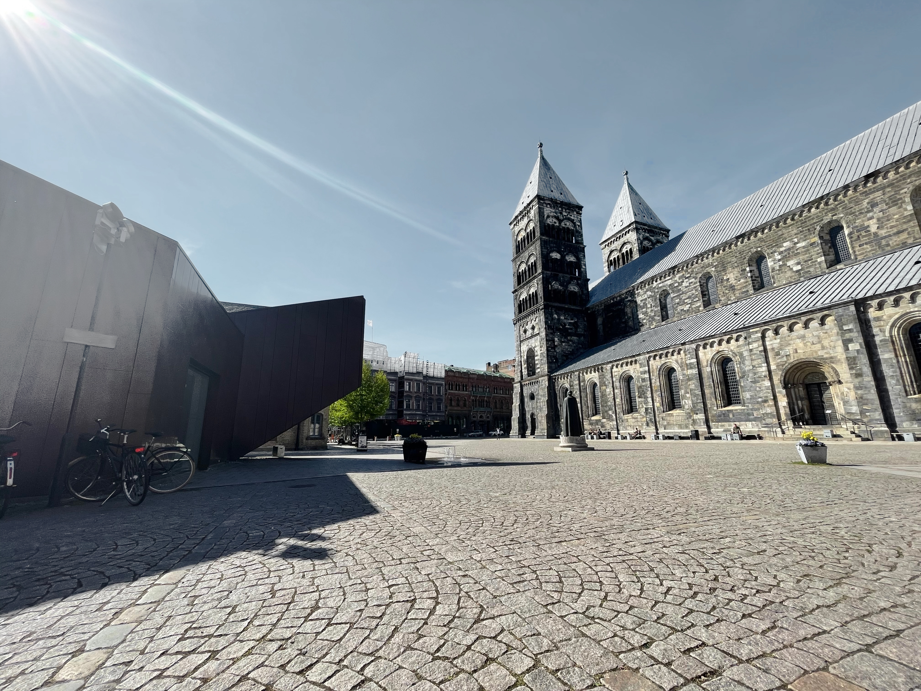

Slide 2
DISCLOSURES

